Slide 1
Atomic Structure
Essential Question: What makes up an atom?
Objective: We will diagram the parts of an atom.

Slide 2
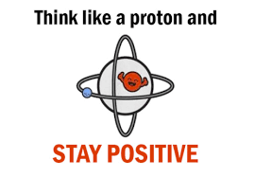
What are the parts of an atom?
Nucleus: Center of the atom that holds the protons and neutrons
Proton: Positively charged part
Neutron: Neutrally charged part

Slide 3
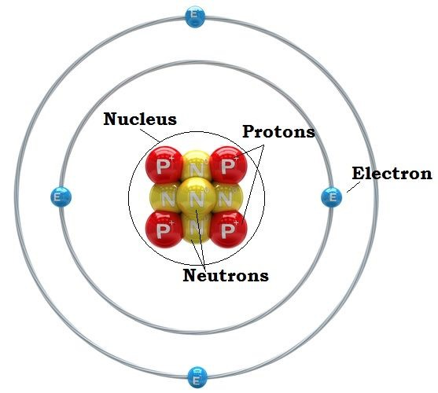
What are the parts of an atom?
B. Orbital or Cloud: the area surrounding the nucleus where electrons are held
Electron: Negatively charged part
that moves around the nucleus

Slide 4
2. How small is an atom?
Watch video to answer question: Just how small is an atom? Video
https://duckduckgo.com/?q=electron+cloud&ia=videos&iai=FMlZq9NG_lo

Slide 5
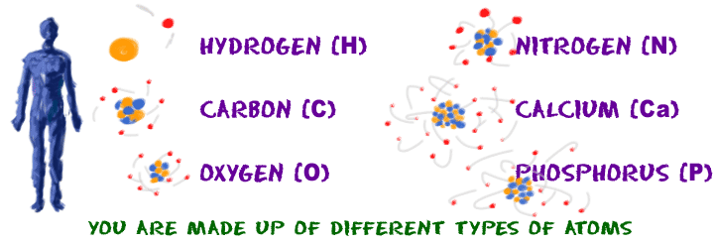
3. What are the differences between atoms?
Every element has its own number of protons, neutrons, and electrons
The periodic table helps us identify the amount of each part

Slide 6
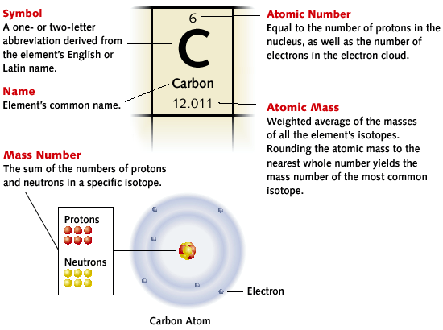
3. What are the differences between atoms?

Slide 7
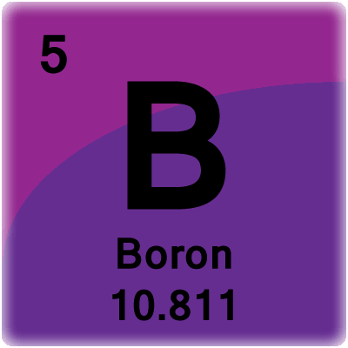
4. How do we find data on specific elements?
Proton amount: Same as atomic number (top)
Electron amount: Same as number of protons
Neutron amount: Mass number(round bottom #)-atomic # (top)
Ex) Boron: Protons =
Electrons =
Neutrons =

Slide 8
Summary
Atom Part | Symbol | Charge | Location | Mass (atomic mass unit)
Proton | p+ | + | nucleus | 1.0073
Neutron | n | 0 | nucleus | 1.0087
Electron | e- | - | cloud/ orbital | 0.00055

Slide 9
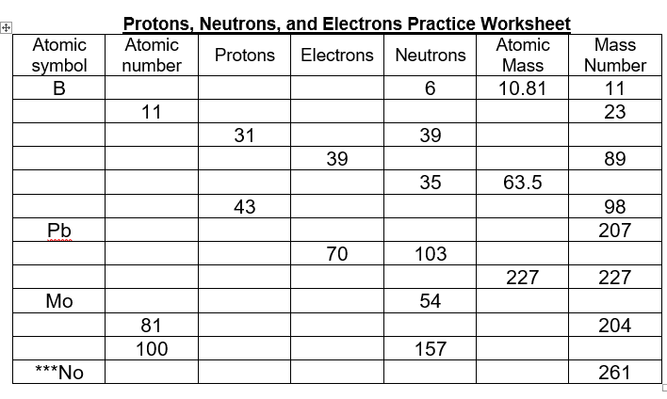
4. How do we find data on specific elements?
Typo 99

Slide 10
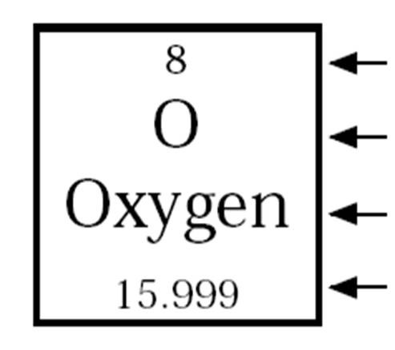
Closure:

